Slide 1
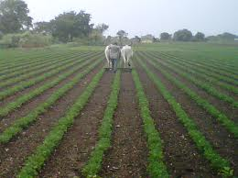
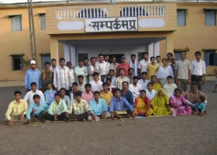
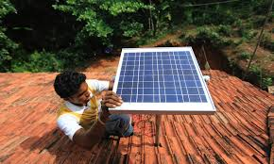
Brief Profile of Sampark Samaj Sevi Sansthan
Strengthening Communities through Holistic Development

Slide 2
Contents
Sampark Samaj Seva Sansthan – An Introduction
Programme Coverage
Key Donors
Awards and Recognition
Key Results

Slide 3
Sampark Samaj Seva Sansthan
A Non Profit Development Organisation
Foundation Year: 1990
Registered Under
The Societies Registration Act, 1973.

Slide 4
Aims & Approach
Aim: To enable the marginalised people to become self reliant and strengthen the Community--
Through promotion of sustainable livelihood practices
Improving Health and Nutrition
Better Education and Skill Development
Development and Management of Natural Resources
Approach: Participatory action at the Community level.
Emphasis: Focus is on to create community level social platforms for awareness and members’ active engagement

Slide 5
We work for Holistic Development, through
Community-based Natural Resources Development with focus on land & water resources development.
Income Enhancement through Farm and Off Farm based livelihoods’ interventions
Promotion of Better Health and Hygiene practices through behavioral Change and construction of Infrastructure with a focus on Child and Women Health
Identification and Enrolment of tribal kids and adults for education at different grades with a focus on Primary Education
Policy Advocacy and creating Awareness among Community Members and other Stakeholders
Capacity Building of Community Institutions including PRI is a cross cutting theme
Use of Appropriate Technology, Credit Linkages for sustainability of Community based institutions

Slide 6
Community Based Development Approach
Household
Village
SHG / CIG
Block
District
Green Energy
Thematic Areas –
Inclusive Growth
Community
Livelihoods
Holistic & Sustainable Development
at Family and community Level
Natural Resource
Management
Education
Health
Policy Advocacy
Awareness and
Village Campaigns
Capacity
Building
Appropriate
Technology
Credit &
Finance

Slide 7
Thematic Areas – Key Focus
Natural Resource Management
Soil and Water Conservation
Infrastructure Development (Dugwells, Canal Restoration etc..)
Education
Buniyadi Shala
Green Energy
Roof Rain Water Harvesting System Demonstration Program..
Livelihoods
Health
Agroforestry
Sustainable Farm Practices
Dairy
Reproductive Child Health
Breed Improvement and Livestock based Livelihoods
Nutrition
Early childhood Care Devt.
Malaria & HIV/AIDS
Swasthya Saheli Program
Science center
School Quality Imprt. Prog.
Reading Skill Improvement
Solar Energy System

Slide 8
Sector Expertise
Implementation of projects on community based natural resources management sector covering community mobilization, financial inclusion, sustainable agriculture and Off Farm Activities etc.
Extending technical support to NGOs, Govt. deptts./projects and building capacities of families, community members and other stakeholders on NRM. Health, Education and Livelihoods etc.
Policy Advocacy on Social Issues, NRM and Human Rights through Community Mobilisation, Awareness Campaigns and establishment of Community Platforms.
Has affiliation with district, State and National Level Agencies in the areas of Health, Education and Natural Resource Management
Has successfully advocated and Institutionalised Policy Change in the areas of -
Land & Water Policy
Agriculture
Tribal Issues
Livestock Policy
Eradication of harmful traditions and reinforcement of bad traditions

Slide 9
Human Resource and Financial Status
Around 55 Professionally Qualified Staff works with the Organisation
Staff Profile includes disciplines such as agriculture, engineering, rural development, social works, Mass Communication, general management, accountancy and general management
Organisation also works with Associate Consultants who are engaged on project basis
There are more than 100 para professionals staff
Rs 1.62 Cr from Projects (FY – 15-16)
>Rs 5 Cr through Convergence and Community Contributions

Slide 10
Sampark Samaj Seva Sansthan – An Introduction
Programme Coverage
Key Donors
Awards and Recognition
Key Results

Slide 11
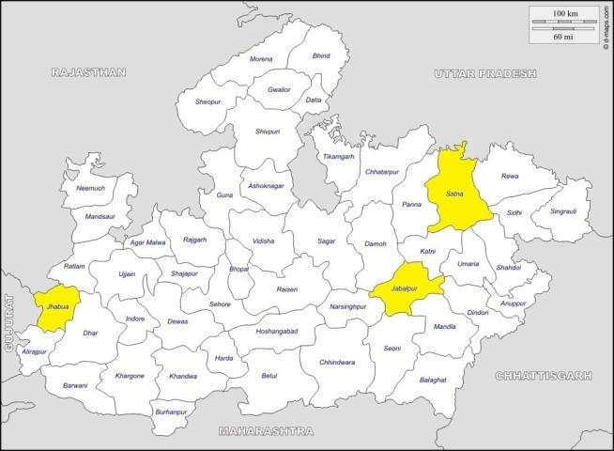
Geographical Outreach
3 Districts of Madhya Pradesh
8 Blocks covering over 584 villages directly working with over 40,000 poor rural families or nearly 2,00,000 population
>90% of members, we work with, belong to Tribal and Other Socially Disadvantaged communities.

Slide 12
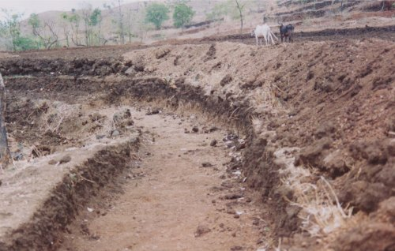
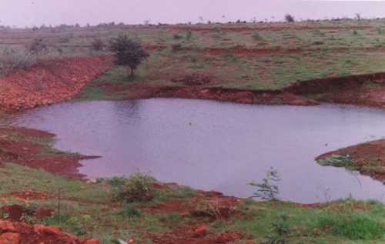
Land and Water Resources Development Program
Watershed Developments
Canal Restoration
Micro Irrigation
Construction of Check Dams
Deepening of Dugwells

Slide 13
Agriculture Productivity Enhancement Programmes:
Agro Forestry and Soil & Water Conservation Program
Promotion of sustainable agriculture - Responsible Crop Initiative [Good Agriculture Practices, Responsible environmental and social practices ]
Participatory Varietal Selection and Promotion
Farmers’ Field School
Vegetable gardens and Poshan Vatika
Trees on farm / Agro-forestry
Application of ICT in Agriculture

Slide 14
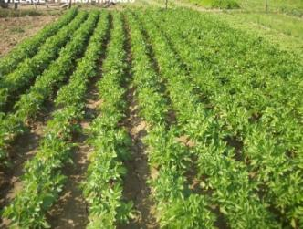
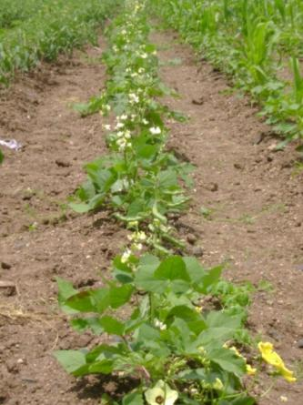
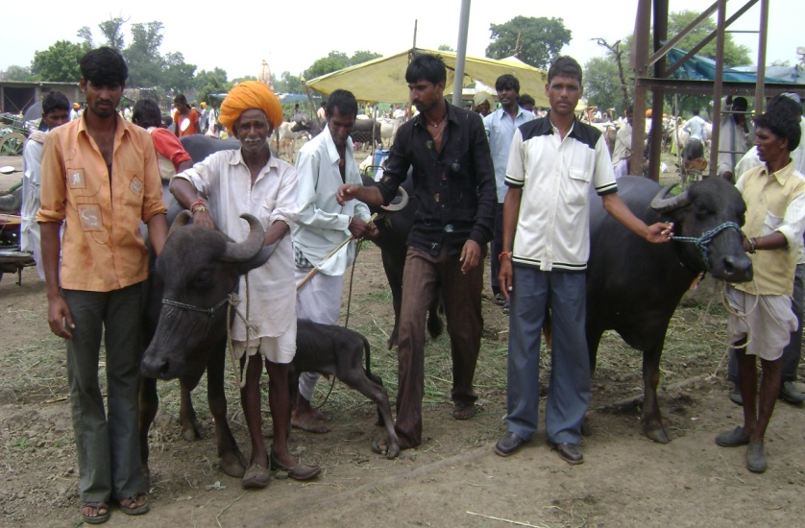
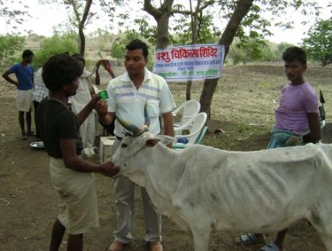
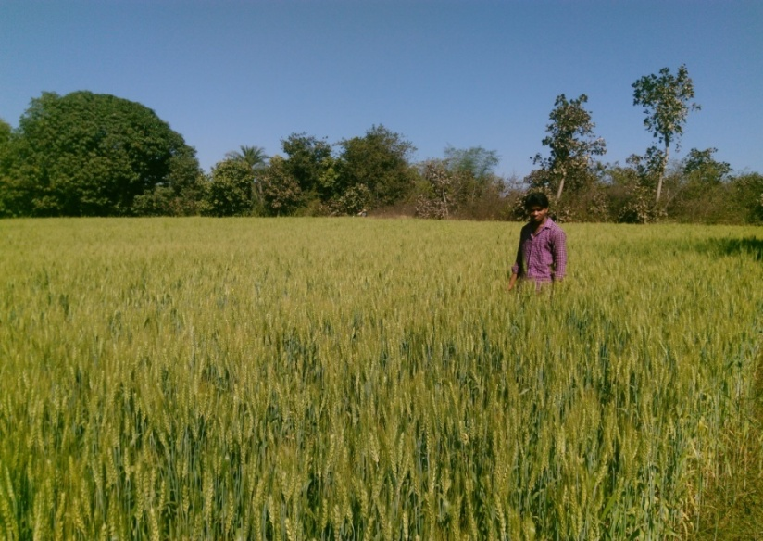
Livelihoods Program

Slide 15
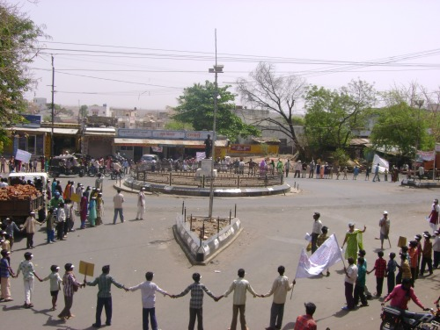
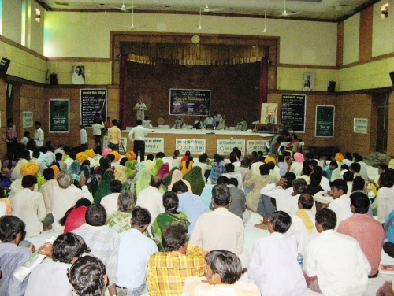
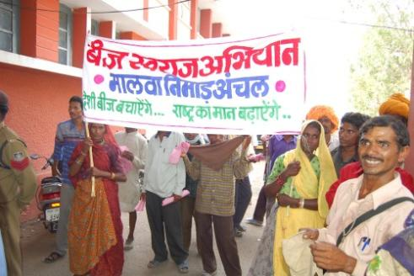
Policy Advocacy and Awareness Campaigns

Slide 16
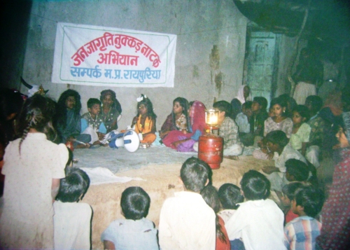
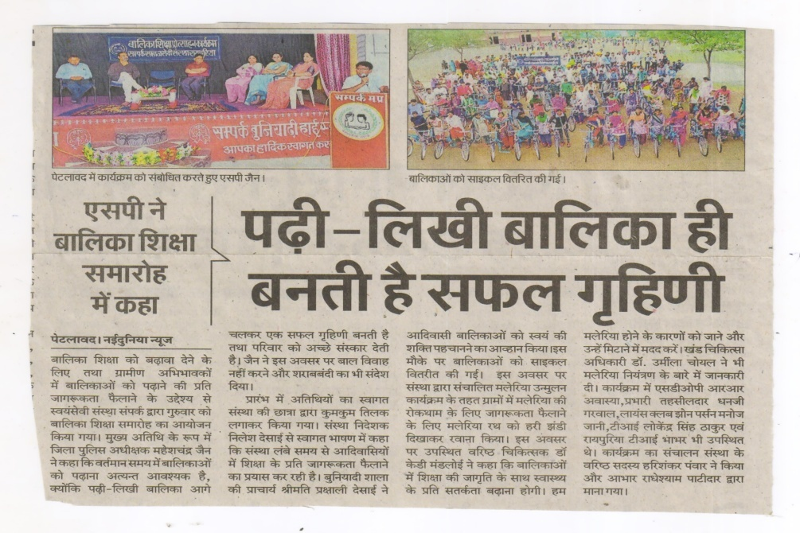
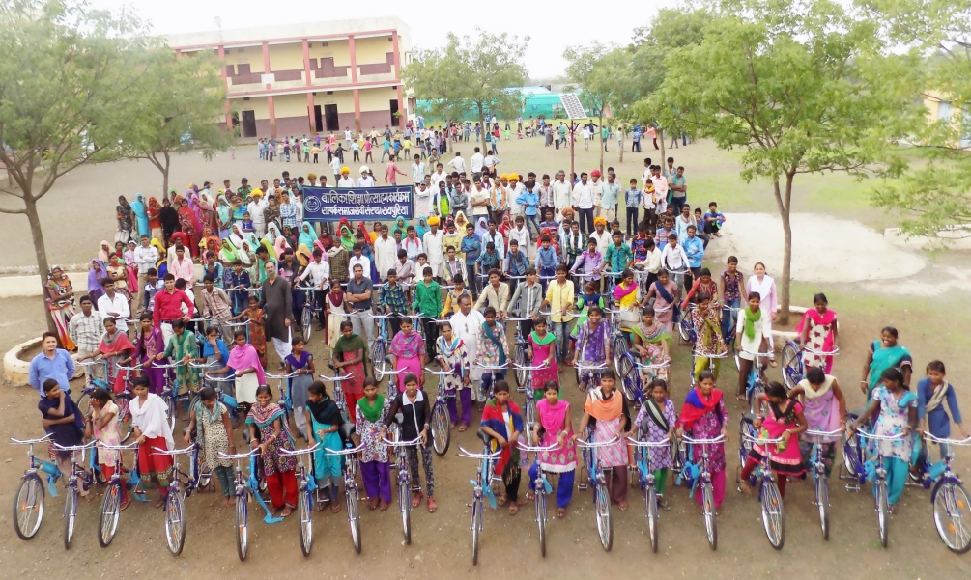
Education

Slide 17
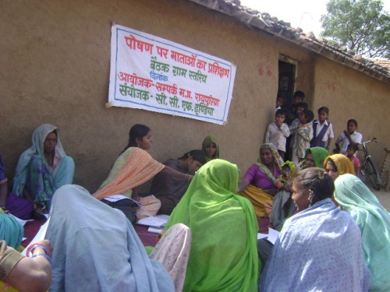
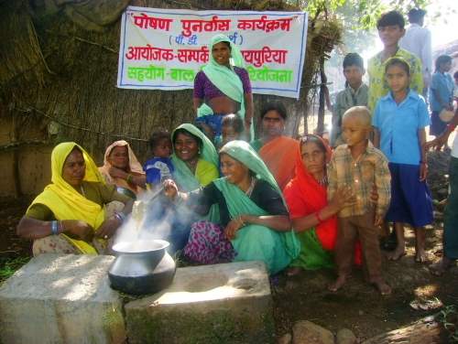
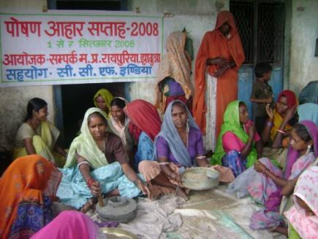
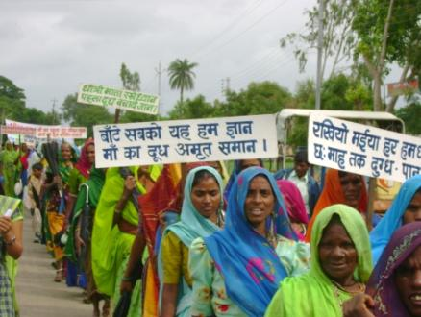
Health

Slide 18
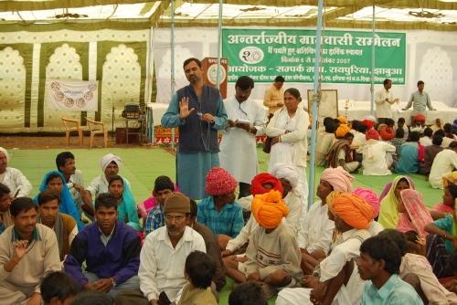
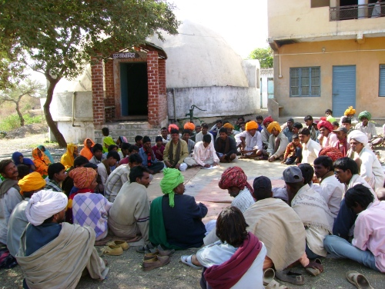
Community Mobilisation and Capacity Building

Slide 19
Sampark Samaj Seva Sansthan – An Introduction
Programme Coverage
Key Donors
Awards and Recognition
Key Results

Slide 20
Government Ministry of Rural Development, GoI , Min. of Agriculture, Panchayats & Rural Development Deptt., M.P.RLP, ChildLine, CAPART New Delhi, SIDBI and MP Council of Science and Technology. National Donor Organisations Sir Dorabji Tata Trust, Galvmed, UBS, SRTT, SAPLLP, Godrej and Goonj International Donor Organisations UNDP, Action Aid, OXFAM, Swiss Aid, IPAS Development Foundation, German Agro Action, CFI, Green Peace, IGSSS, Safronie Foundation, Embed, SAPPLLP, Galvmed, UBS, Ford Foundation, DFID, CASA, Danida and ICRISAT
Funding Organisation (On-going & Past)

Slide 21
Sampark Samaj Seva Sansthan – An Introduction
Programme Coverage
Key Donors
Awards and Recognition
Key Results

Slide 22
Awards & Recognition
National Youth Award - 1988-89, Human Resource Development Ministry, New Delhi
Certificate of Appreciation for Exemplary work in the area of Social Development - 1989-90, District Rural Development Agency, Jhabua.
Ashok Gondhia Award – 2010, Young Men Gandhi Association, Rajkot, Gujarat
Champaben Gondhia Award -2010, Young Men Gandhi Association, Rajkot, Gujarat.
Tarun Bharat Environmental Protection Award -2013, National Water Community (Tarun Bharat Sangh) Rajasthan.
Letter of Appreciation - 2017, Anavil Society Navsari, Gujarat.
Appreciation Letter for promotion and Support to Nutrition campaign -2016-17 DM, Jhabua

Slide 23
Sampark Samaj Seva Sansthan – An Introduction
Programme Coverage
Key Donors
Awards and Recognition
Key Results

Slide 24
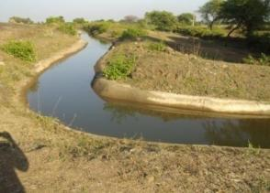
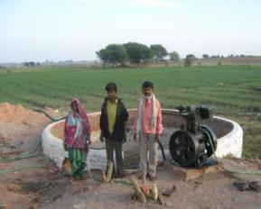
Deepening of 148 dugwells, deepening of 10 percolation tanks, installation of 10 tubewells and the testing of water have improved availability of potable drinking water for a population of 40,000 in Jhabua District
Construction of 13 checkdams, 292 dugouts, 1449 Gully plugs, 6315 metres of contour trenches, 1782 hectares of field bunds and the recharge of 552 dugwells resulted in 4000 hectares of land being irrigated benefiting 15,500 people.
Fertile Silt from percolation tanks has been dugout and spread on 5000 hectares of land making it more productive.

Slide 25
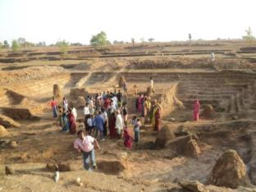
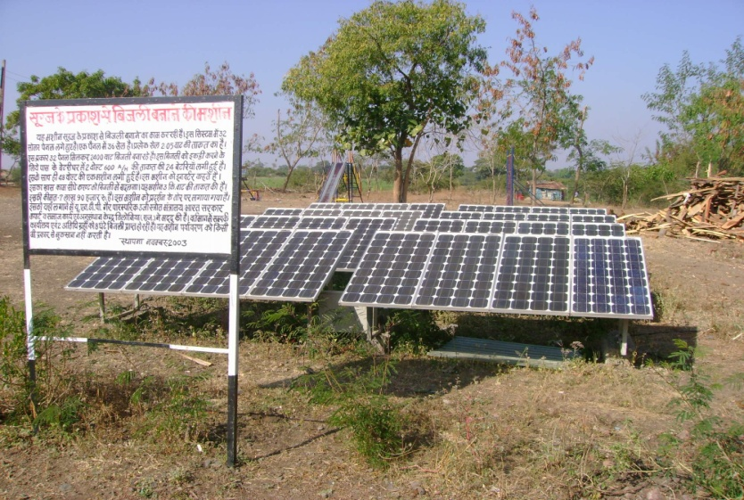
1600 households in 65 villages were provided with smokeless wood stoves considerably reducing the problem of women arising from inhaling too much smoke. The consumption of firewood has also been reduced by 50 percent as these stoves are more fuel efficient which reduces the load on the environment and also the women who have to gather fuelwood.
200 households in 10 villages have been provided with solar lighting resulting in savings in the use of kerosene to the tune of 20000 litres over the decade and also greater lighting in the homes.

Slide 26
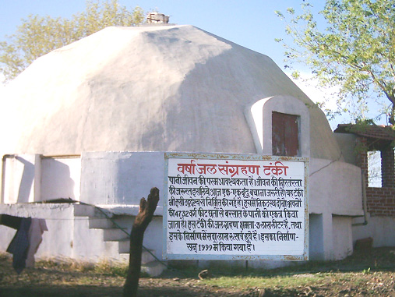
50000 litre underground water tanks have been constructed in which over the last 10 years 15000 children have been benefited . The total water so harvested over the decade is 1,25,00,000 litres
Roof water harvesting of 48,00,000 litres annually is done in the campus. In addition 50,00,000 litres of waste water per year is also recharged into the ground after treatment.
500 households in 50 villages have been trained in sustainable agricultural practices like organic manure preparation, indigenous seed conservation and propagation and herbal pesticide preparation. Work is in progress to make 10 villages completely organic and free from chemical inputs

Slide 27
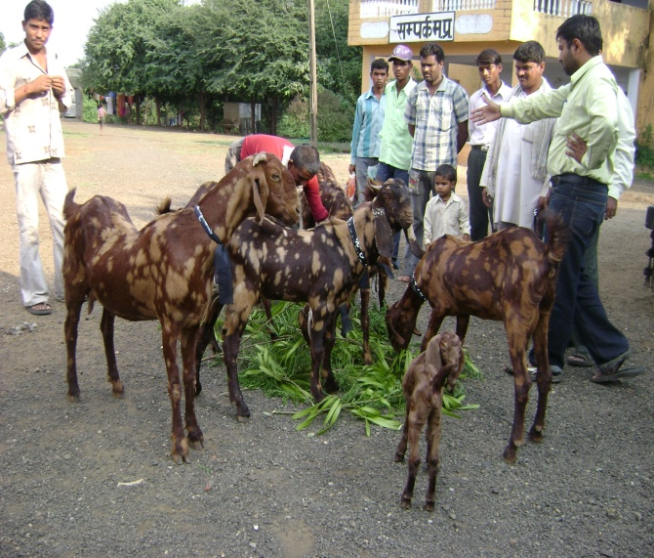
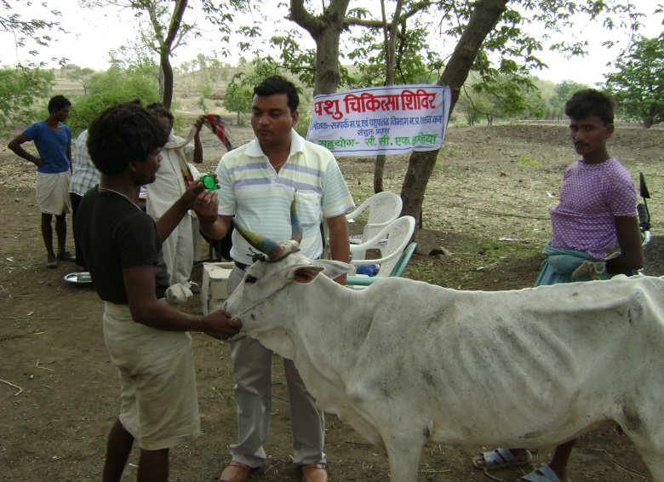
More than 40,000 Families across 333 villages were supported through animal extension Services for Goatery and Poultry.
A cadre of 120 paravets called Sakhis/Mitr, well trained to take care of the goats and birds.
Mortality rate came down to less than 9% from 63%.
Income increment by more than 40% for the families
Promotion of more than 500 indigenous varieties of Goat and Poultry Birds

Slide 28
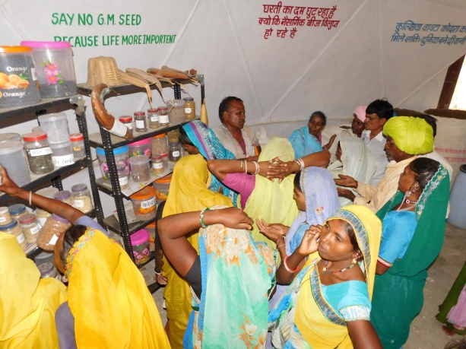
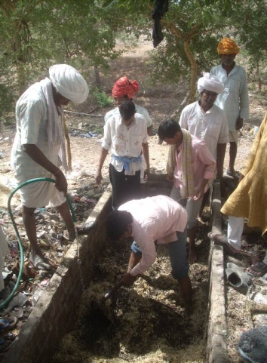
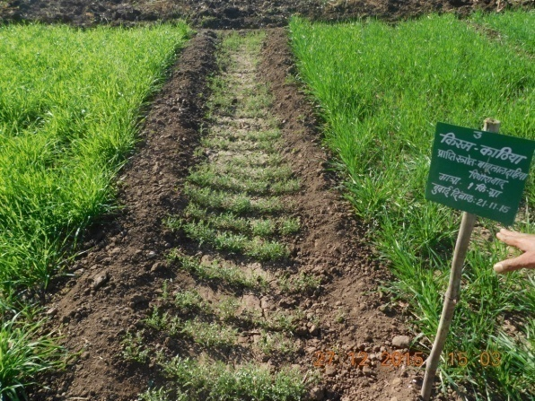
Over 10000 small and marginal tribal farmers every year to adopt good agriculture practices
Under the Good Agriculture Practices regime, more than 5000 farmers shifted from broad casting of seeds to "Line Sowing" in more than 4000 acres
Restored 7 different indigenous varieties of Minor Millets
yield increment is measured more than 50-60 %; significant reduction in cost of production
Average income increased by 227% per acre

Slide 29
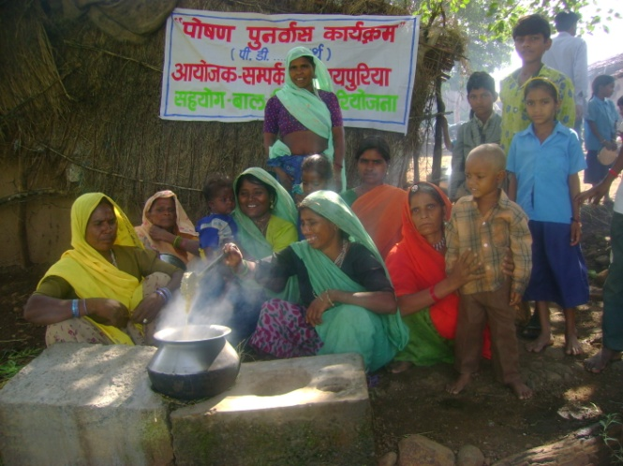
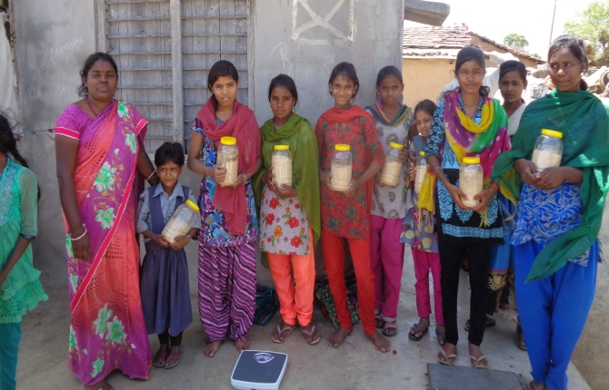
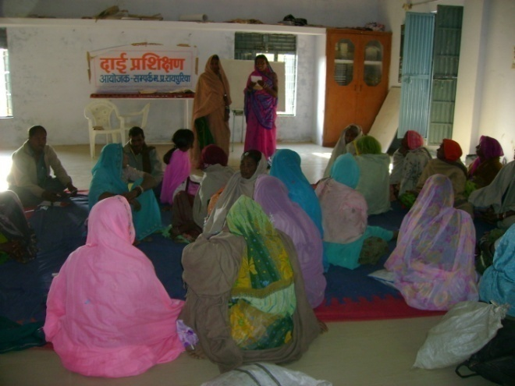
Awareness campaigns in 17 villages covering 1000 Families along with distribution of mosquito nets to children in schools and regular checkups and follow-ups have resulted in prevention and quick cure of malaria and benefited a population of 20,000 people.
118 women were trained to be birth attendants or dais and 50 women have been trained as Swastha Sahelis. Both have basic training in reproductive and gynecological health and provide immediate relief and care to village women. 1480 women have benefited from these services.
The people of these villages are made aware of the need for immunisation and provision of proper nutrition to children and are assisted in accessing the Government health system for this. 3030 infants have been immunised and 1706 women have been provided with the institutional delivery services.

Slide 30
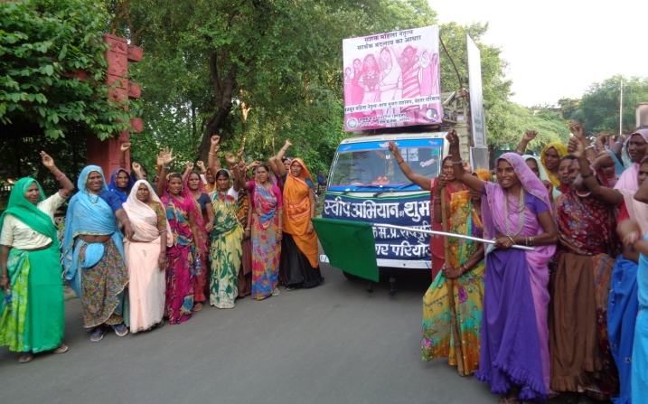
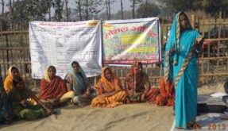
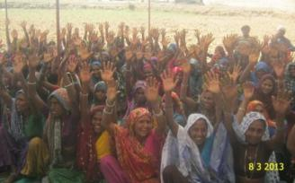
The participation of women in the Gram Sabha meetings has increased. Elected Women Representatives (EWR) submitted 4750 applications for pensions, 370 applications for the construction of school buildings, 35 applications for Anganwaris, 98 applications for Kapil Dhara dugwells which have mostly been sanctioned.
19000 women have got employment in the Mahatma Gandhi National Rural Employment Guarantee Scheme resulting in a cumulative income of Rs 4 crores and the construction of assets such as tanks, roads and school buildings. 1200 adolescent girls have been given health training and 9000 women have been given health checkups. 900 toilets and 3 sub health centres have been constructed.
3965 women members of 200 SHGs have saved Rs 65 Lakhs which has provided them with economic self reliance and freedom from debt bondage to usurious moneylenders.

Slide 31
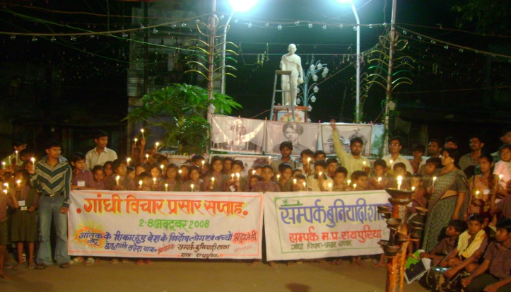
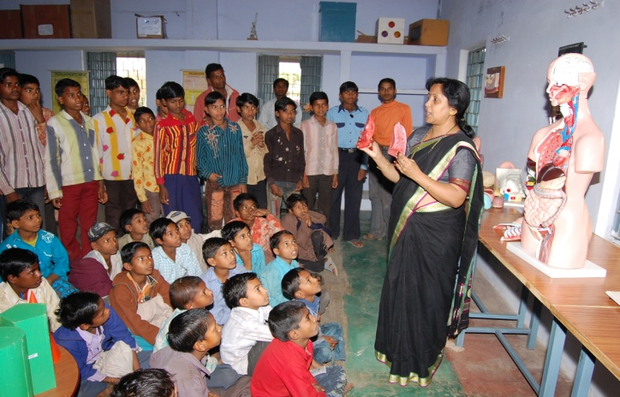
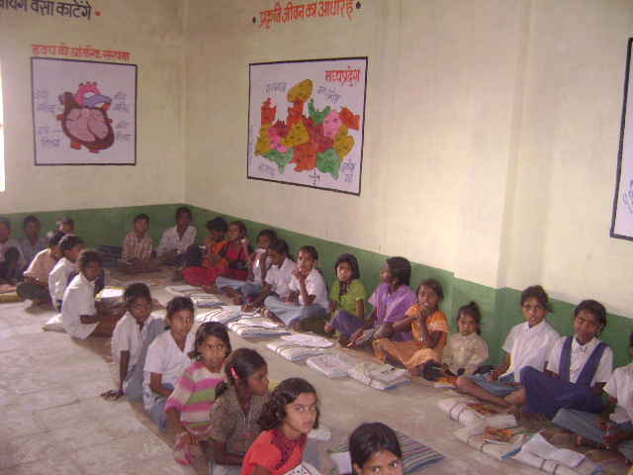
Quality Education is provided to over 12000 children studying in 150 Government Primary Schools and their educational levels have increased as a result.
240 dropout children in 40 villages were brought back to mainstream school education through the provision of training in the residential schools
2500 children from remote villages in Petlawad Tehsil being provided quality residential education in the school in the Sampark Campus at Raipuria based on Gandhiji's concept of "Nai Talim“
Over the past decade more than a 12,000 children across 30 Villages who cannot study during the day due to various reasons have been taught in these night schools and mainstreamed to formal school education system
A mobile library covers 60 villages and provides 8,000 children with books to read which has led to an increase in reading and analytical skills in the children
Over 300 Tribal youth have been given a detailed training in pedagogic techniques which has improved the quality of teaching in schools in the Tehsil

Slide 32
Mr. Nilesh Desai (Director) Sampark Gram, Post Raipuria Petlawad – 457775 Jhabua, M.P.
Tel: +91-7391-280185, 265832 Mobile: +91- 9425486993
Email: ndesaisaampark@gmail.com
Website: www.samparkmp.org
Contact Details

